Slide 1
BANK LOAN OF CUSTOMER ANALYSIS
By Group 2

Slide 2
Members
1. Mr. Santosh Rottayyanavar
2. Mr. Hakim Fakruddin Sadik
3. Mr. Samba Shiva
4. Mr. K S Chennaveeragauda
5. Mr. Vivek Sonnad
6. Mr. Kunal Sahebrao Mahaske

Slide 3




Tools Used

Slide 4
Introduction
Data contains information of bank loan
Here we have analyzed the year wise loan amount and grade and sub grade wise revol balance
The scope of this project is to analyze the data to meet the required KPIs with the help of tools like MS Excel, Power Bi, Tableau and SQL.

Slide 5
KPI’s
Year wise loan amount stats
Grade and Subgrade wise revol balance
Total payment for verified and non verified status
State wise last credit pull_d wise loan status
Home ownership Vs last payment date stats

Slide 6
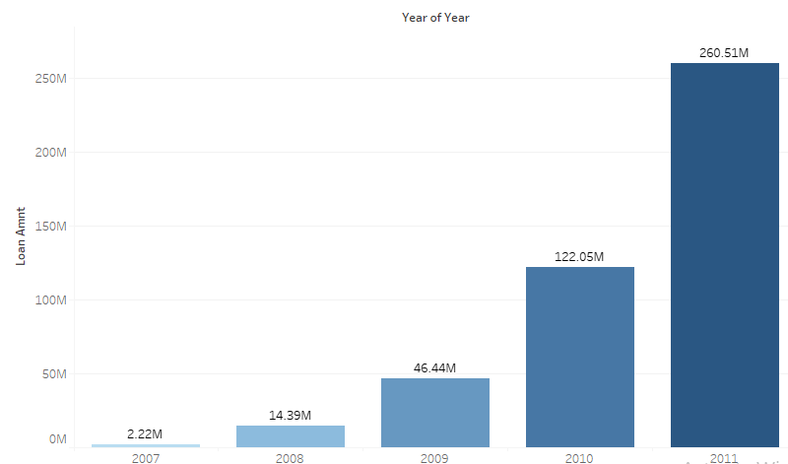
Year wise loan amount stats
The loan amount is maximum in 2011. Which is 260M
The overall trend of loan amount is increasing year by year

Slide 7
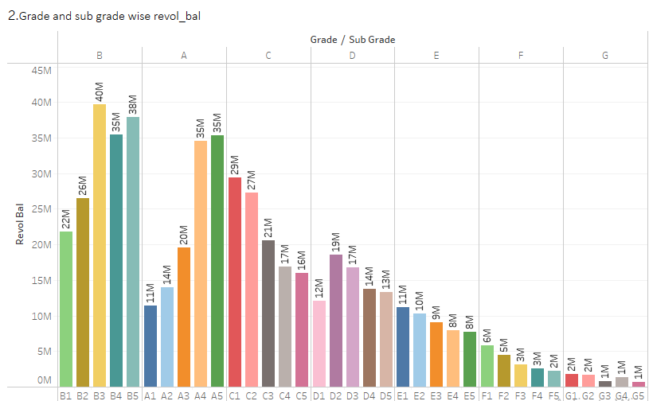
Grade and Subgrade wise revol balance
The grade B is showing high revol balance as compared to other grades. Which is 30.5%
The grade G is showing low revol balance as compared to other grades. Which is 6 %

Slide 8
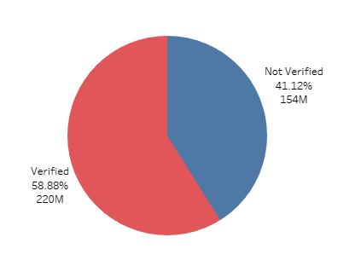
Total payment for verified and non verified status
The total payment of verified status is maximum. Which is 220M(58.88%)
The total payment of non verified status is 154M(41.12%)

Slide 9
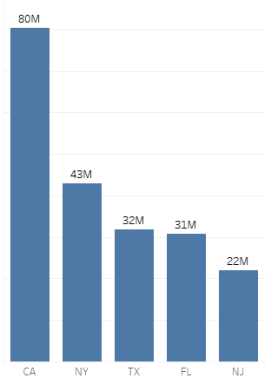
State wise loan status
Top 5 states according to loan status
California has maximum loan amount. Which is 80M
Maine has minimum loan amount. Which is 9k

Slide 10
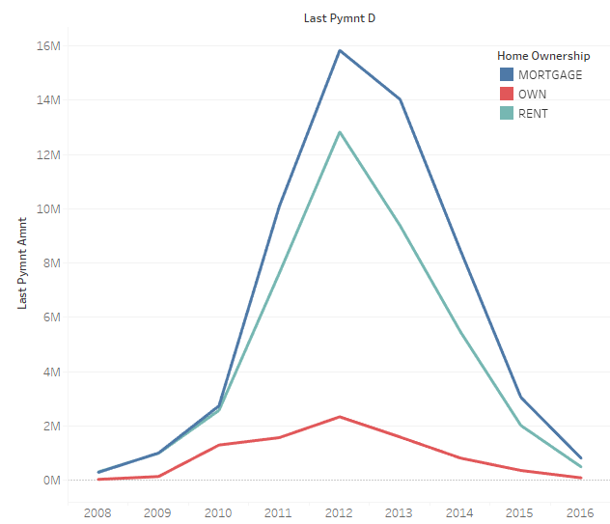
Home ownership Vs last payment date stats
The last payment amount is maximum in 2012
The last payment to t amount is increasing from 2008 to 2012
It was maximum in 2012 for all home ownership status
Again the trend is decreasing from 2013 to 2016

Slide 11
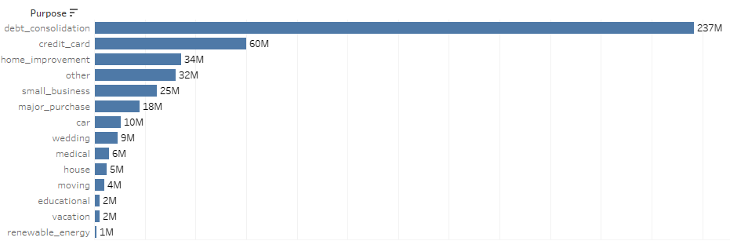
Purpose wise loan amount

Slide 12
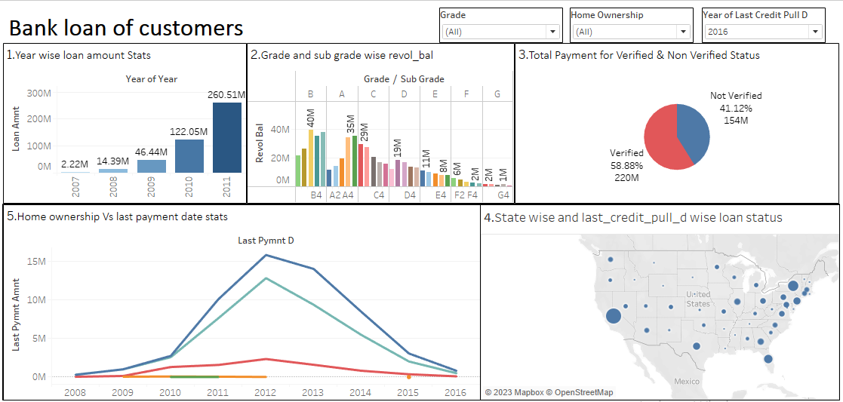
Tableau Dashboard

Slide 13
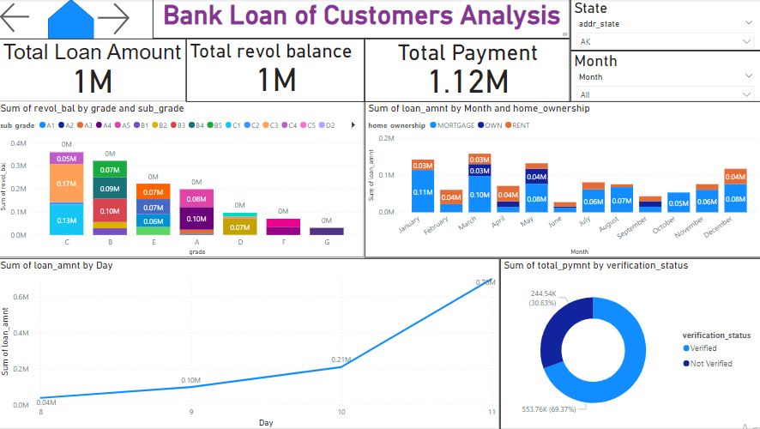
Power Bi report page

Slide 14
Thank You

